Slide 1


Relational and Logical Operators
Where do I find MATLAB? Here!
Do I have to have MATLAB installed on my computer right now? No, you can use MATLAB Online!

Slide 2

Table of Contents
Recap of Week 2, Part 1: Arrays and Matrices
Decision Making with Operators
Introduction to decision making with operators
Relational Operators
Logical Operators
What we've covered this week in part 2: Relational and Logical Operators
Extra resources
References
MATLAB Live Script

Slide 3
Recap of Week 2, Part 1: Arrays and Matrices
This week in part 1, we learnt about:
What arrays and matrices are
Creating arrays
Indexing into arrays
Concatenation of arrays
Operating with function on arrays
In the next part of this week's content, we will be learning about relational and logical operators, covering the following sub-topics:
Introduction to decision making with operators
Relational operators
Logical operators

Slide 4
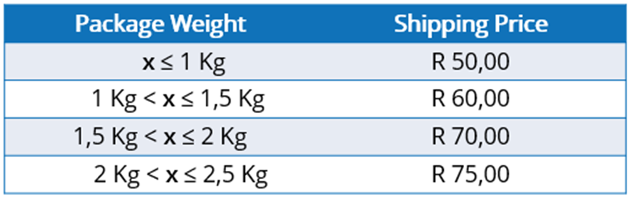
Decision Making with Operators
Introduction to decision making with operators
To give context to this section, we will be considering a packing shipping example. Let us call this company Package Shippers, who has worked out the most profitable price to charge their customers depending on the weight of the package they request to be couriered/shipped. For simplicities sake, let us assume that Package Shippers don't ship packages that weigh more than 2.5 kilograms. The formula they use is based on the following table:

Slide 5
Decision Making with Operators
If a customer were to bring in a package that weighs 1.75 Kg, the shipping price that the customer would be charged is R 70.00. The process of determining this is easy for most humans because we understand relational and logical operators, i.e. determine what price the customer should be charged using the pricing rules described in the table above.
Before we jump into how these operators are defined or used operators, let us consider our line of thinking when applying the pricing rules described in the table above. The weight of the package is supplied to us, and we determine which row of the Package Weight column the supplied weight fits. One could start at the top or the bottom row, asking for example "Is 1.75 Kg less than or equal to 1 Kg?". We know this is not true, so we move to the proceeding row, asking; "Is 1.75 Kg greater than 1 Kg and less than or equal to 1.5 Kg?", and so on. Once we find the pricing rule question that is true, we then refer to the Shipping Price in that same row. The illustration below helps visualise this graphically.

Slide 6
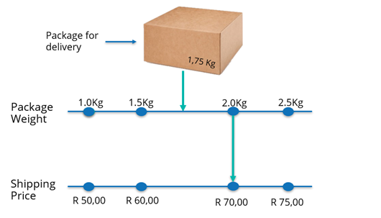
Decision Making with Operators
When values or numbers are being compared, for example "Is 1.75 Kg less than or equal to 1 Kg?", we are making use of a relational operator, "less than or equal to"/ . The outcome to a statement that includes a relational operator is always logical, i.e. a true or false, and we can combine two or more logical outcomes by means of a logical operator (and/or), for example "Is 1.75 Kg greater than 1 Kg and less than or equal to 1.5 Kg?".

Slide 7
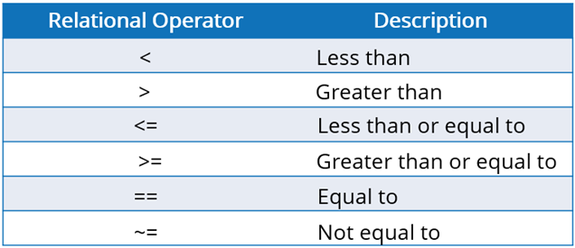
Relational Operators
Relational operators, also known as conditional operators, are used to compare two variables/values to determine if the condition is true or false, for example the outcome of π ≥ 3 would be true while the outcome of π ≤ 3 would be false. The outcomes of such statements are logical values which can only take on a value of 1 (when true) and 0 (when false). The following table has the relational operators you'll need for programming:

Slide 8
Relational Operators
Let us put these into practice by considering the example mentioned above:
pi >= 3
ans = logical
1
pi <= 3
ans = logical
0
Note: The outputs are of type logical.

Slide 9

Relational Operators
Now you try! As with functions, relational operators can also be applied to arrays, let us demonstrate this through some exercises. Let us consider two randomly generated integer vectors arr_1 and arr_2:
arr_1 = randi(50,[1 10])
arr_1 = 1×10
18 30 12 38 13 26 35 45 48 28
arr_2 = randi(50,[1 10])
arr_2 = 1×10
7 8 13 43 13 41 13 47 18 10

Slide 10
Relational Operators
Which elements of arr_1 is greater than or equal to the corresponding element in arr_2? Assign the answer to the variable logical_arr_1 for use later on.
logical_arr_1 = arr_1 >= arr_2
logical_arr_1 = 1×10 logical array
1 1 0 0 1 0 1 0 1 1
Which elements of arr_2 is greater than 10? Assign the answer to the variable logical_arr_2 for use later on.
logical_arr_2 = arr_2 < 10
logical_arr_2 = 1×10 logical array
1 1 0 0 0 0 0 0 0 0

Slide 11
Relational Operators
Now you try! In the two exercise questions above, we saw the application of relational operators to the vector arrays. Now, let us consider two exercises that demonstrate the application of relational operators on matrix arrays. Consider the following two randomly generated integer matrices, arr_3 and arr_4:
arr_3 = randi(50,[4 4])
arr_4 = randi(50,[4 4])
Which elements of arr_3 is less than their corresponding elements in arr_4?
arr_3 < arr_4
Which elements of arr_4 is greater than or equal to 20?
arr_4 >= 20
Note: Relational operators can be applied to arrays of any order. We only covered the application of relational operators in the case of scalar, vector, and matrix arrays. Consult the documentation for the Array Comparison with Relational Operators for more information.

Slide 12
Relational Operators
Wondering where you encounter relational operators in your everyday life?
A relational operator is applied when a comparison or relation between two variables/values is required. In life, we continuously make decisions around time, place, factors in our environments or our personal experiences. We get to define our morning alarm time, where our favourite reading spot is, how loud to play our music, and so on. These decisions are always made with some frame of reference in mind, like the time of day, the position we are located on Earth, the level of stimulation our unique bodies experience, etc. These frames of reference can be seen as one of the entities we compare with or relate to, in order to make our decisions.

Slide 13

Relational Operators
If you got lost in the explanation above, let us consider a particular example to focus on. Imagine that we are looking to purchase and sell bread rolls for a profit. Each bread roll costs us ZAR 5.00
Two potential customers approach us with an offer. The first potential customer offers us ZAR 4.50 for a bread roll, the second offers us ZAR 8.00 for a bread roll. As we are selling bread rolls with the intention of making a profit, we would reject the offer made by the first potential customer and accept the offer from the second one. This is because the selling price must be greater than our cost price in order for us to generate profit from the transaction.

Slide 14
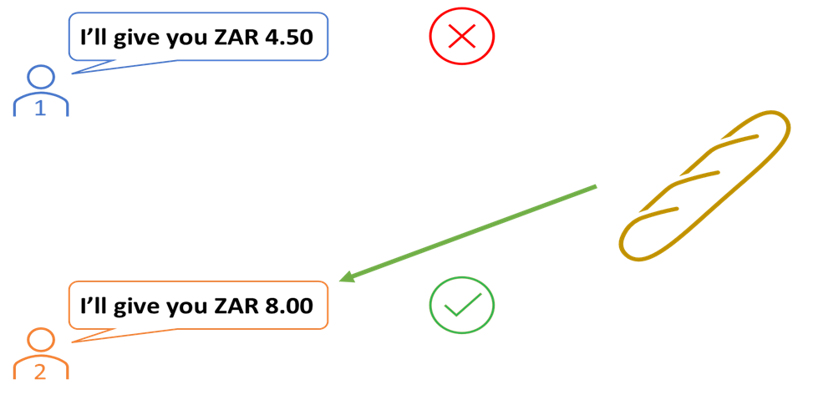
Relational Operators
Let us consider the line of thinking that our brains might follow when choosing to accept or reject the offers. Assume that the question we ask ourselves is, "Is this offer profitable?". If this is true, we would consequently accept the offer, and if it is false, we will reject the offer.

Slide 15
Relational Operators
Begin by defining our cost price and the two offers we receive:
Cost_price_in_ZAR = 5.0;
Offer_1_in_ZAR = 4.5;
Offer_2_in_ZAR = 8.0;
Let us test is each of the offers are greater than our cost price:
Is_Offer_1_Profitable = Offer_1_in_ZAR > Cost_price_in_ZAR
Is_Offer_1_Profitable = logical
0
Is_Offer_2_Profitable = Offer_2_in_ZAR > Cost_price_in_ZAR
Is_Offer_2_Profitable = logical
1
We received a logical response for Is_Offer_1_Profitable of 0, indicating false, i.e. we should reject the first offer. For the second offer, we received a logical response for Is_Offer_2_Profitable of 1, indicating true, i.e. we should accept the second offer.
3

Slide 16
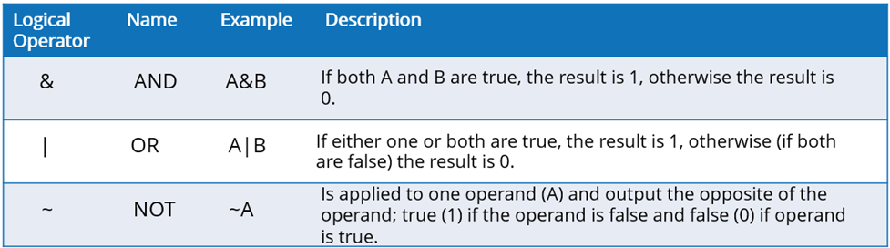
Logical Operators
Logical operators are used to compare two statements to determine if the condition is true or false. As with relational operators, the outcome of a comparison using a logical operator will be of type logical, which can only take on a value of 1 (when true) and 0 (when false). The following table has the basic logical operators you'll need for programming:
These operators can be applied to scalars and arrays of higher orders/dimensions.

Slide 17
Logical Operators
Let us consider the above-mentioned operators to logical_1 and logical_2 as defined below:
logical_1 = true;
logical_2 = false;
logical_1 & logical_2
ans = logical
0
logical_1 | logical_2
ans = logical
1
~logical_1
ans = logical
0
3

Slide 18
Logical Operators
In a similar way, we can apply logical operators on logical arrays, of any order. Recall the logical arrays we computed in the previous subsection, log_arr_1 and log_arr_2, let us apply the & operator to them.
logical_arr_1
logical_arr_1 = 1×10 logical array
1 1 0 0 1 0 1 0 1 1
logical_arr_2
logical_arr_2 = 1×10 logical array
1 1 0 0 0 0 0 0 0 0
logical_arr_1 & logical_arr_2
ans = 1×10 logical array
1 1 0 0 0 0 0 0 0 0

Slide 19
Logical Operators
Note: If you have cleared your workspace, you will need to run the section where logical_arr_1 and logical_arr_2 are defined. The logical arrays produced will be different each time you run the section, this is because they are based on randomly generated integer arrays.
Now you try! Create a row vector, arr_5, with 5 elements between the values of 1 and 10 using the randi function. Determine which elements are smaller than 4 or greater than 6.
arr_5 = randi(10, [1 5])
arr_5 = 1×5
3 8 8 4 6
arr_5 < 4 | arr_5 > 6
ans = 1×5 logical array
1 1 1 0 0

Slide 20
Logical Operators
Wondering where you encounter logical operators in your everyday life?
The decisions we make every day are often complex and based on several factors/conditions. In the relational operators section, we considered the most simple form of decision making, i.e. there are two values/quantities that were being compared. Here, we will be considering an instance where two outcomes of relational operator conditions are combined to make a decision. The key here is that two statements are being compared instead of two variables/values.
Let us consider a decision where we choose to light a candle or not for our study area. Let us consider a case where we have access to an electric light and a candle (with a working lighter) as the two sources of light in our study area.

Slide 21
Logical Operators
Taking the decision to light the candle would depend on if we have an electricity supply or not, and if we require light in your study at the time (how dark the environment is). Let us define these conditions as yes or no questions:
Does the study area have sufficient light?
Do we have an electricity supply available?
We assume that there is only one reason why you would light a candle to be used as light source, this is when both questions (conditions) are answered with a "no", i.e. the study area does not have sufficient light, and we do not have an electricity supply available.
The other combinations of outcomes can be summarised as follows:
If there is not sufficient light in the study area and we have an electricity supply, then we can use out electric light
If there is sufficient light available in the study area, then there is no need to light a candle or to use an electric light.

Slide 22
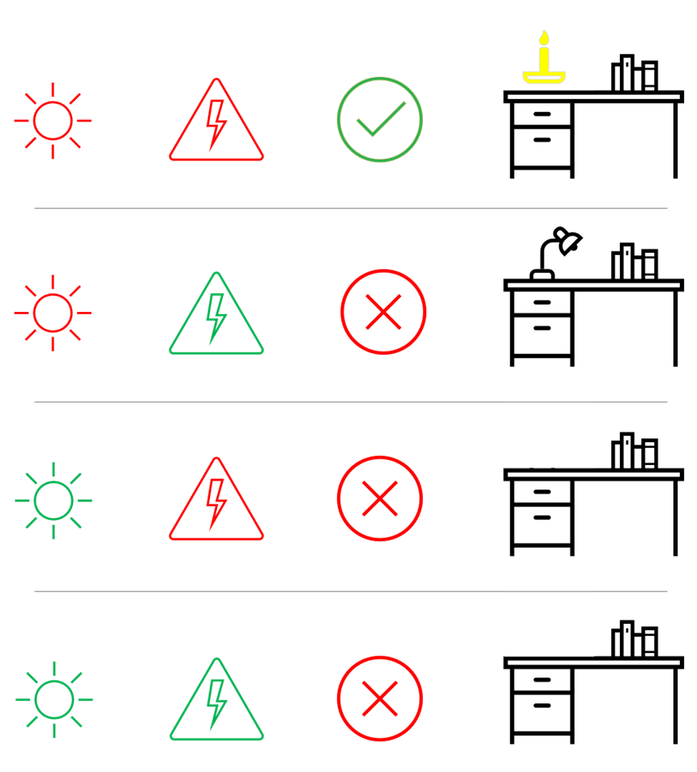
Logical Operators
Let us represent the combinations of condition outcomes and the decision taken in an illustrative manner. Note that we depict an answer of "yes" to either of the questions by a green icon, and an answer of "no" by a red icon.

Slide 23
Logical Operators
Let us now define this using some code. We assume that an answer of "yes" and "no" are true and false, respectively.
Question_1_Answer = true;
Question_2_Answer = true;
Should we light a candle for our study area?
~Question_1_Answer && ~Question_2_Answer
ans = logical
0

Slide 24
What we've covered this week in part 2: Relational and Logical Operators
This week in part 2, we learnt about:
What arrays and matrices are
Creating arrays
Indexing into arrays
Concatenation of arrays
Operating with function on arrays
In the next part of this week's content, we will be learning about relational and logical operators, covering the following sub-topics:
Introduction to decision making with operators
Relational operators
Logical operators

Slide 25
Extra resources
Documentation: MATLAB Fundamentals
Documentation: Find Array Elements That Meet a Condition
Documentation: Logical Operators: Short-Circuit && ||
MATLAB Fundamentals Self-paced Course
Self-Paced Online Courses

Slide 26
References
Documentation: MATLAB Fundamentals
Copyright 2022 The MathWorks, Inc. & Opti-Num Solutions (Pty) Ltd.

Slide 27
MATLAB Live Script
Click on the link below for this lecture’s MATLAB live Script
Week_2_Part_2_Relational_and_Logical_Operators.mlx

